Slide 1
Dealing with Death in the Workplace
Maria Capati
Senior Associate
TasBus Conference 1 June 2013

Slide 2
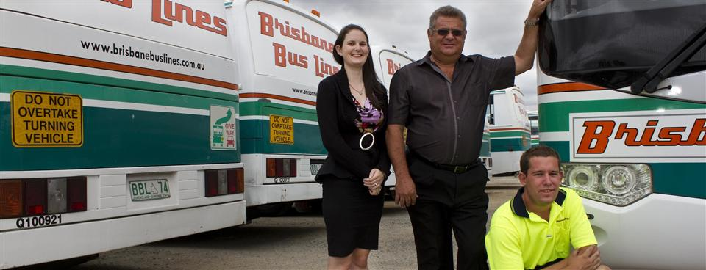
Death of an employee at a bus depot
Employee caught between a saloon door and the body of a coach.
Excessive force and fast closing speed

Slide 3
Work Health and Safety Act 2012 (Tas)
Section 8. Meaning of workplace
(1) A workplace is a place where work is carried out for a business or undertaking and includes any place where a worker goes, or is likely to be, while at work.
(2) In this section –
place includes –
(a) a vehicle, vessel, aircraft or other mobile structure; and
(b) any waters and any installation on land, on the bed of any waters or floating on any waters.

Slide 4
Immediate Response
Lock down the site
Do not let anyone interfere with the scene until have the consent of Workplace Standards and the police
Important to leave the area secure
The bus was seized by the police
Consider how much of the site should be closed down and for what length of time
Quite easy to shut off a corner of the bus depot in our instance

Slide 5
Immediate response continued
Identify the employees who were involved in the incident
Who found her, who did CPR, who called the police etc.
Obtain statements from eye witnesses within the first few hours after the incident
Do not contaminate the evidence of witnesses by telling them what other witnesses have said

Slide 6
Immediate response continued
Call your lawyer
Notify next of kin
Know your facts before you speak to the family
Notify Workplace Standards, Workcover, Transport Commission, your insurer and the policy (if fatality)
Arrange a person to deal with any media enquiries

Slide 7
Immediate Risk Assessment
This is a judgement call – avoid speculation
Do a risk assessment of the hazard that caused the incident and issue the risk warning immediately
Safety alert was issued to all drivers (they had to sign for it) re the emergency safety switch
Need to give requisite warning of any change in practice, procedure or just alert
Provide to TasBus for general publication

Slide 8
Internal Investigation
Have your lawyers investigate internally
Important for legal professional privilege
Important in order to conduct witness interviews
Consider whether external expert needs to be engaged to assist the investigation team
In this instance, a forensic engineer was engaged by WHSQ and another for ourselves

Slide 9
Internal investigation continued
Prepare an incident report
Strong argument that legal professional privilege will apply to the documents created out of such an investigation
Avoid creating any new documents about the incident (except for documents prepared for your lawyers)
Such documents tend to involve speculation, may be incriminating and could be used later in court proceedings

Slide 10
Legal Professional Privilege
Protects communications between a lawyer and a client
Disclosure is not required if the dominant purpose of the advice is for use in existing or anticipated legal proceedings.
The privilege is that of the client and the privilege can be expressly or impliedly waived (eg. disclose legal advices or reference something which betrays the confidence of it)

Slide 11
How to deal with your employees
Have counselling made available
Give strict instructions to your management staff about the following to other staff:
What to say
When to say
What not to say
Do not speculate

Slide 12
How to deal with your employees continued
You are in the midst of a Workplace Standards investigation
No emails or other documents should be created regarding the incident
The staff that were involved in the incident also need to be well managed

Slide 13
Workplace Standards Investigation
Workplace Standards inspectors have extensive powers to speak with witnesses and access documents
They will call the employees involved in the incident for interviews
They will re-interview employees
They will interview any employees involved in previous similar incidents

Slide 14
Workplace Standards Investigation continued
Nominate and maintain one point of contact for all Workplace Standards enquiries, include documents and requests for interviews
In our case it was the HR Manager
one person should be responsible for obtaining and collating all relevant documents to the incident (need to get consent of MD for release)
Prepare a document register and keep it in a secure location (keep copy of everything you give)

Slide 15
Workplace Standards Investigation continued
They will seize and isolate the plant and equipment involved
They initially took away BBL20 but then left it on our client’s site not to be used
Videotaped and timed the door with their forensic engineer
Always have a lawyer onsite with your employees
Sometimes not allowed in the interview

Slide 16
Workplace Standards Investigation continued
Your WHS policy is the first thing that the Workplace Standards inspector will request
Are your policies up to date?
Are your policies readily accessible?
Do the employees know where it is
Do you have evidence of training in WHS of your employees?
Induction training, refresher training, on-the job training etc?

Slide 17
Workplace Standards Investigation continued
In our case they asked for
WHS policy/safety alerts/drivers manual
Manuals for bus doors
Copies of minutes of directors/management meetings
Records of all training done especially re doors
Certain employee files
Details of previous WHS incidents that were similar ➔ extremely critical in our situation

Slide 18
Moving forward
What to do:
Engage in preparing or updating your policies urgently
WHS policy needs to be distinct and separate from other policies
Need to train your employees regarding policies and document training
Do risk assessments of hazards
How are risks identified? How are management aware of issues?

Slide 19
Penalties
For a corporation – maximum penalty is $3,000,000
For an individual/officer – maximum penalty is $600,000 and/or a maximum prison term of 5 years
OHS inspectors have the power to issue infringement notices (on-the-spot fines) for workplace safety breaches – range from $50 - $2,500

